Slide 1


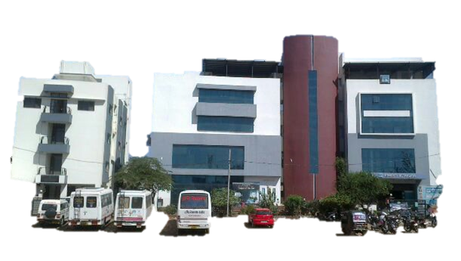
POST TRAUMATIC TELECANTHUS IN PEDIATRIC AGE GROUP
Presenting author:
Dr. Deeksha Thorat
Co authors:
Dr. Shreya Shah
Dr.Mehul Shah

Slide 2
TITLE: : Post Traumatic Telecanthus in pediatric age group

Slide 3
DISCLAIMER
The authors certify that they have obtained all appropriate patient consent forms. In the form the patient(s) has/have given his/her/their consent for his/her/their images and other clinical information to be reported in the journal. The patients understand that their names and initials will not be published and due efforts will be made to conceal their identity, but anonymity cannot be guaranteed.

Slide 4
INTRODUCTION
Medial canthal tendon (MCT) is the pivotal soft tissue in naso-orbito-ethmoid (NOE) area, which supports the canthus, enables proper apposition between the eyelid and the globe, and performs as the lacrimal pump.Post traumatic MCT rupture with telecanthus leads to esthetic and functional impairments.
The aim of the surgery is to restore medial canthal area to its natural and esthetic with preservation of function, for reinsertion or repositioning the MCT that has been avulsed or displaced. Various techniques have been used in the past for this purpose, such as transnasal wiring, titanium screws, titanium miniplates cantilevered from the nose, commercially available anchoring systems (such as those from Mitek Inc., Westwood, Mass), periosteal flaps, and medial tarsal strips.

Slide 5
HISTORY
A 2 YEAR OLD CHILD PRESENTED TO THE OPD WITH A H/O ROAD TRAFFIC ACCIDENT 6 MONTHS AGO.
HE UNDERWENT SURGICAL TREATMENT FOR REPAIR OF FRONTAL AND NASAL BONE FRACTURE WITH SURGICAL SCAR OVER FOREHEAD.
NOW COMPLAINS OF DEVIATION AND WATERING FROM BOTH EYES

Slide 6
EXAMINATION
O/E:
Pt is conscious ,cooperative,well oriented in time,place,person
Afebrlie
Pulse-88/min,RR-18/min
No pallor, icterus, cyanosis, lymphadenopathy

Slide 7
SYSTEMIC EXAMINATION
RS – AIRWAY ENTRY B/L EQUAL
CVS- S1 S2 NORMAL
CNS- CONSIOUS WELL ORIENTED
GIT- SOFT NON TENDER
NO OTHER SIGNS OF INJURY ELSEWHERE IN THE BODY

Slide 8
OCULAR EXAMINATION
BCVA – FIXATION OU
OCULAR MOVEMENTS- DUCTION AND VERSION UNDER NORMAL LIMITS
ORBITAL RIMS NORMAL
FLATTENED NASAL BRIDGE
HYPERTELORISM

Slide 9
ANTERIOR SEGMENT : WNL
POSTERIOR SEGMENT : NO ABNORMALITY DETECTED

Slide 10
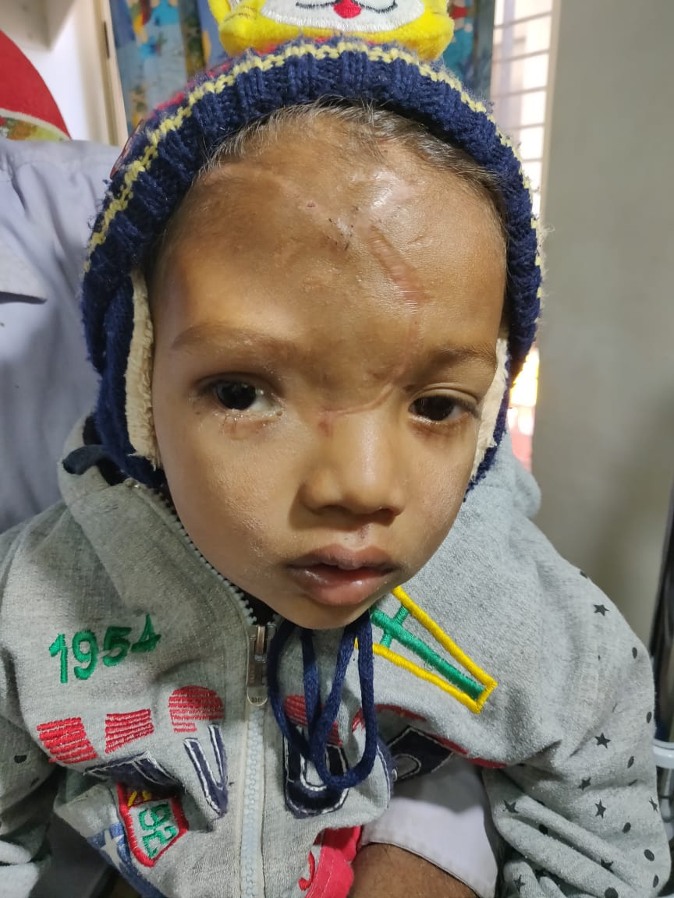
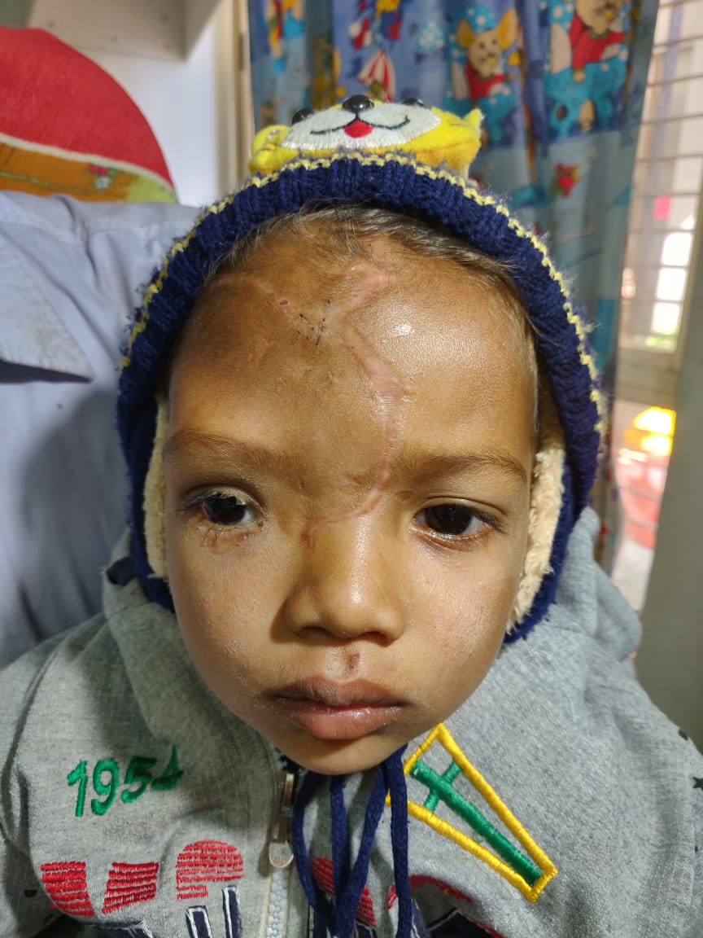

Slide 11
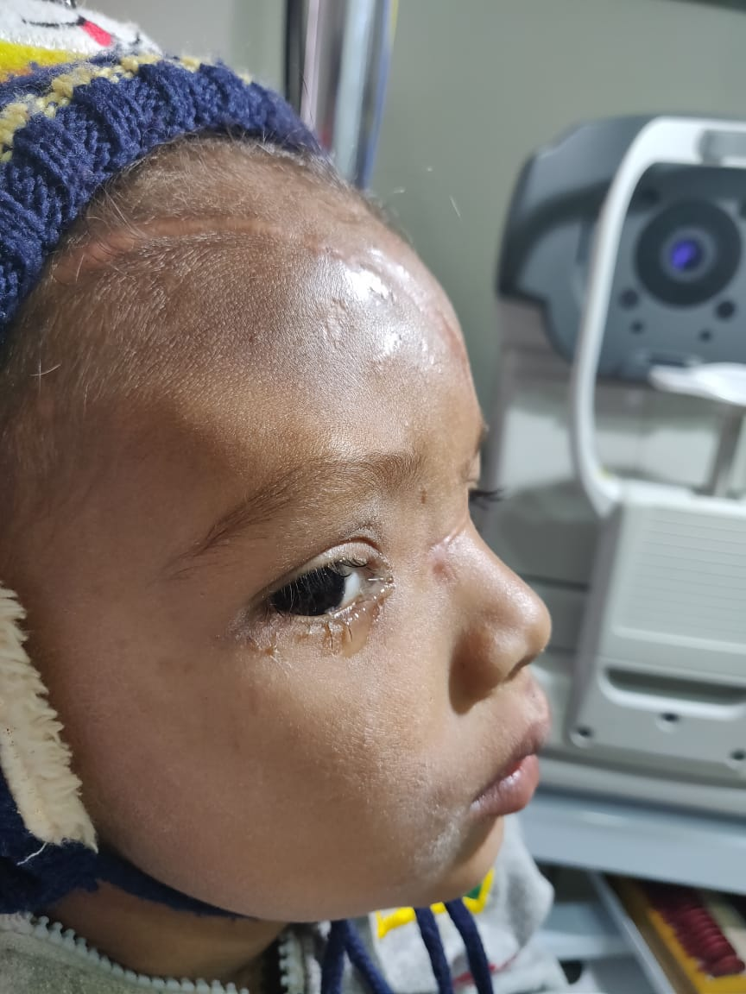
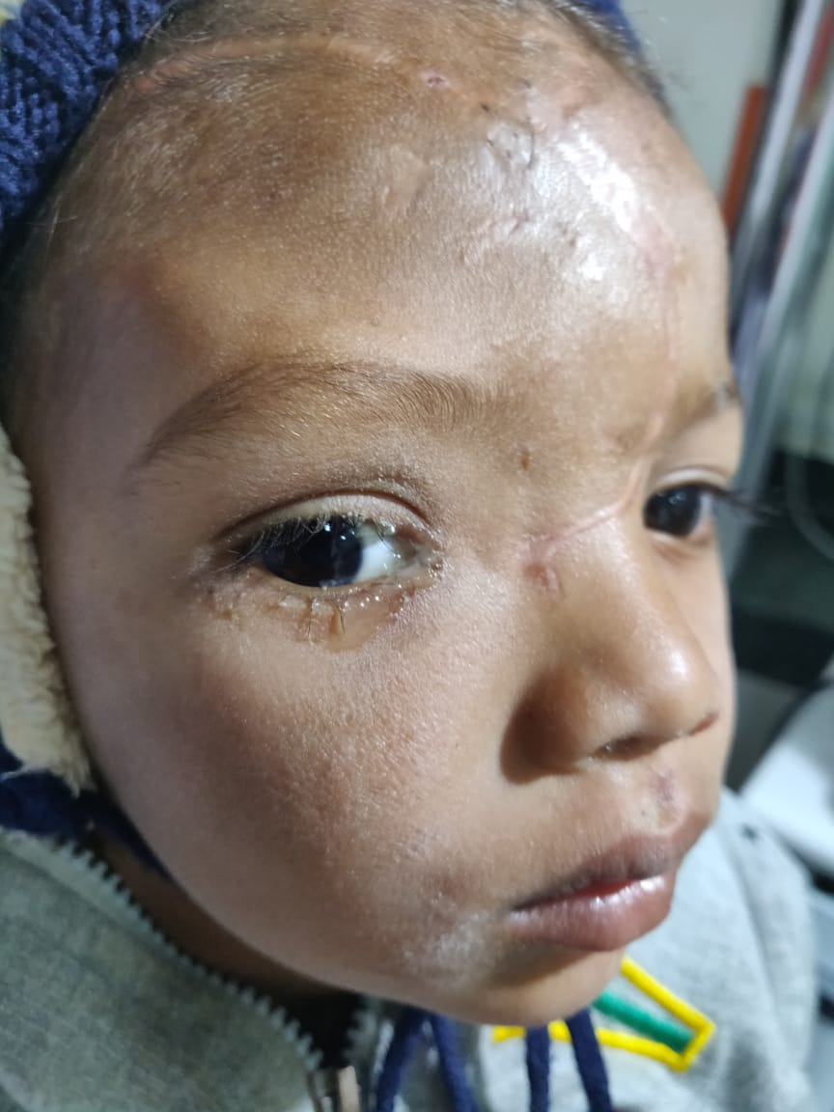

Slide 12
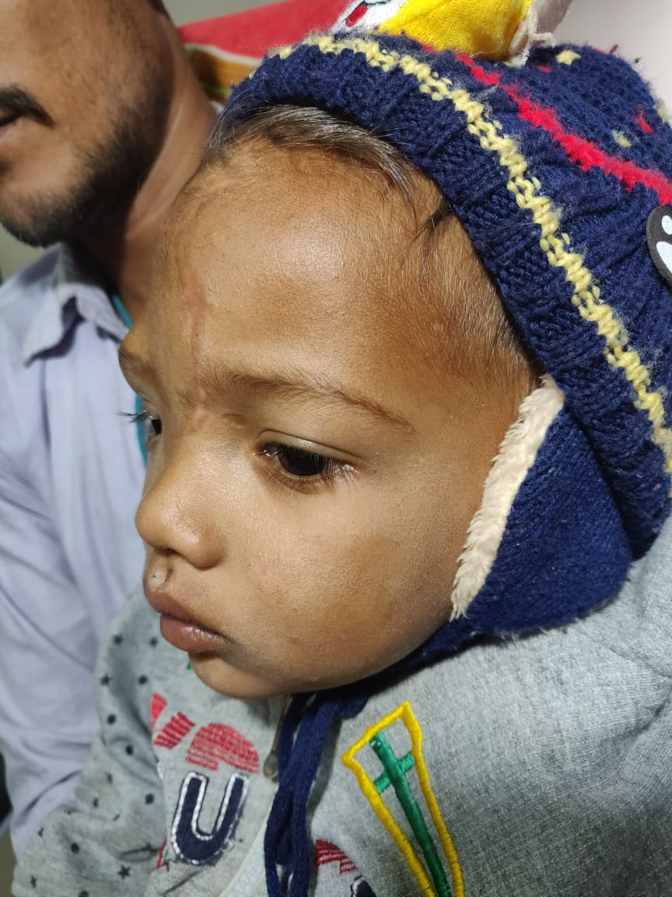
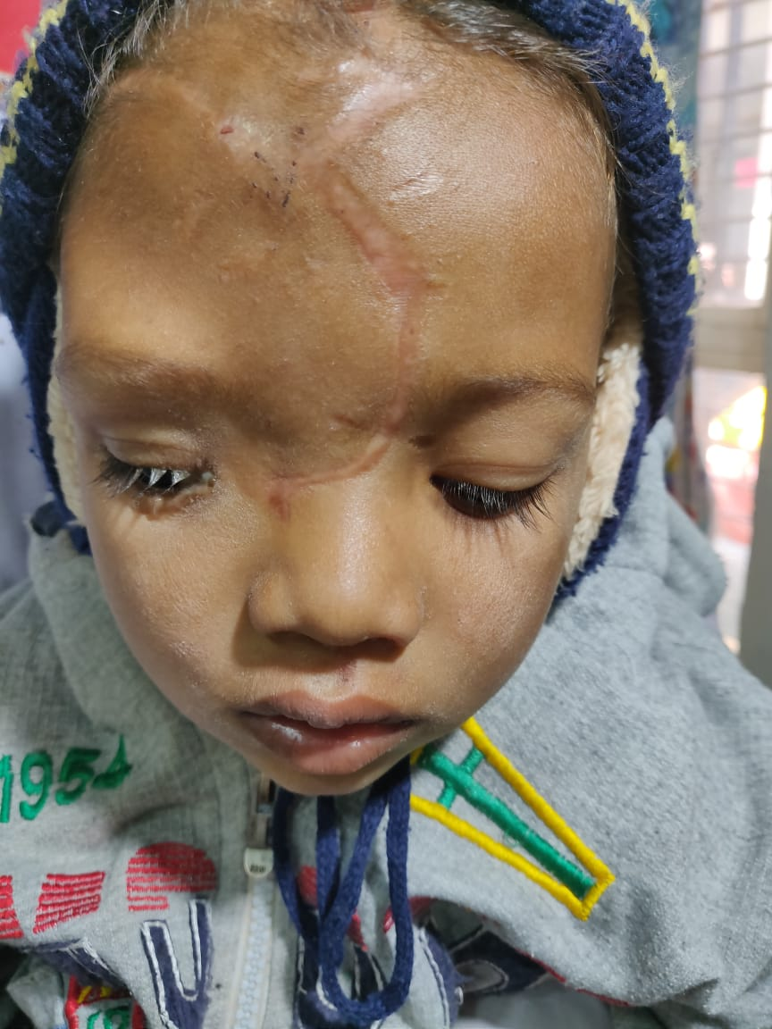

Slide 13
SURGERY PLANNED
3 SURGERIES WERE PERFORMED SIMULTANEOUSLY
MEDIAL CANTHAL TENDON PLICATION
LACRIMAL INTUBATION AND PROBING
V-Y PLASTY

Slide 14
MCT PLICATION
AFTER PAINTING AND DRAPING UNDER ASEPTIC CONDITIONS A SKIN INCISION WAS TAKEN OVER THE MEDIAL CANTHUS
AFTER CAREFUL DISSECTION, THE RUPTURED LATERAL END OF THE MCT WAS FOUND.
SIMILARLY THE MEDIAL END OF MCT WAS FOUND AFTER DISSECTING OVER THE LACRIMAL CREST
4-0 PROLENE SUTURE WAS PASSED THROUGH BOTH THE ENDS OF THE TENDON.
THE ENDS OF THE TENDON WERE APPROXIMATED AND SUTURED KNOT WAS TIED .

Slide 15
LACRIMAL PROBING INTUBATION
SIMULTANEOUSLY AFTER DILATING UPPER AND LOWER LACRIMAL PUNCTA, PROBE WAS PASSED VIA THE COMMON CANALICULAR DUCT INTO A BYPASS TRACT IN THE INFERIOR MEATUS .
A HOLSTER WAS ATTACHED TO THE LOWER END OF THE TUBE AND SKIN SUTURE WAS TAKEN THO KEEP IT IN PLACE.

Slide 16
V-Y PLASTY
AFTER SECURING THE MCT AND PROBING INTUBATION, THE SKIN SUTURES WAS TAKED IN V FASHION WITH 4-0 CATGUT SUTURES.

Slide 17
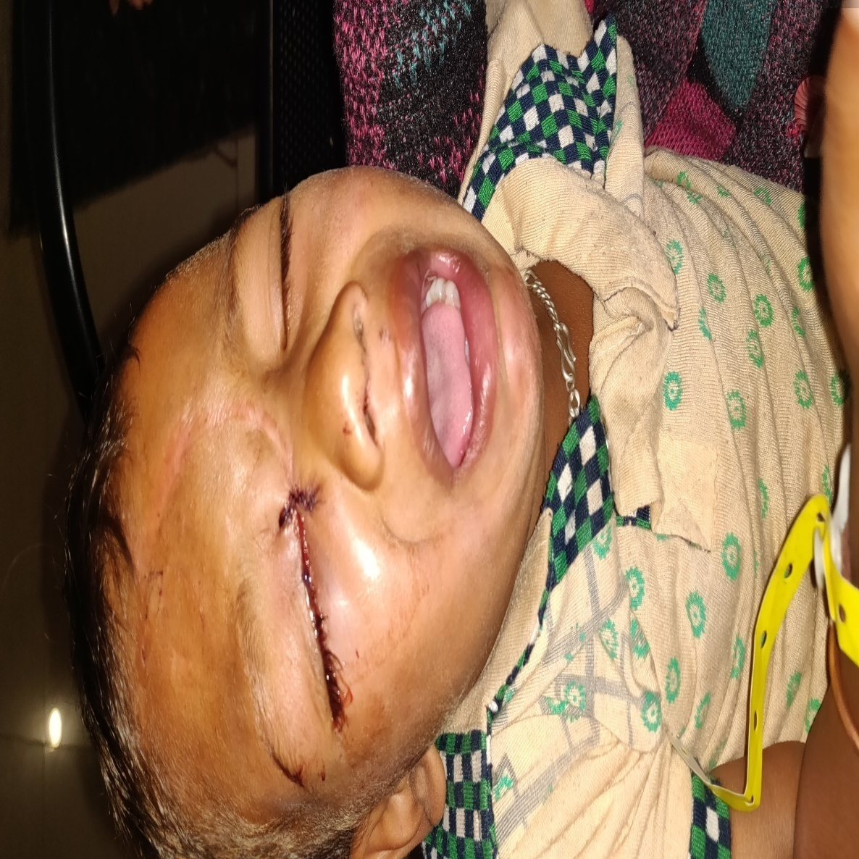
POST OP DAY 1

Slide 18
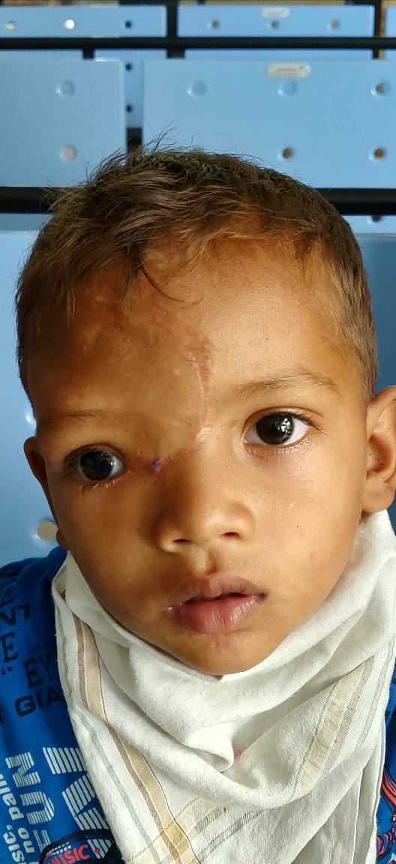
POST OP 1 MONTH

Slide 19
CONCLUSION AND DISCUSSION
Fractures of the nasal and ethamoidal complex account for approximately 5% of facial fractures in adults.
In children, the incidence is higher and NOE fractures account for nearly 15% of all facial fractures.One of the most common complications stemming from NOE fractures is traumatic telecanthus due to injury and the avulsion of the medial canthal ligament.
Surgical treatment of telecanthus carries one of the most challenging tasks in facial reconstruction due to the anatomical complexity of the NOE region and its utmost role in facial expression. Scarcity of tissue in this region makes it difficult to perform the operations without incurring the risk of the destroying the benefits of the preceding intervention.[

